Slide 1

Predicting Sales using Advertising Data
A comparison of regression models
By : Anya Jain

Slide 2

Objective
To apply linear regression modelling in evaluating multivariate relationships between advertising expenditure and sales.
To understand the impact of different advertising channels (TV, Radio, Newspaper) on sales and compare model performance when features are excluded.

Slide 3
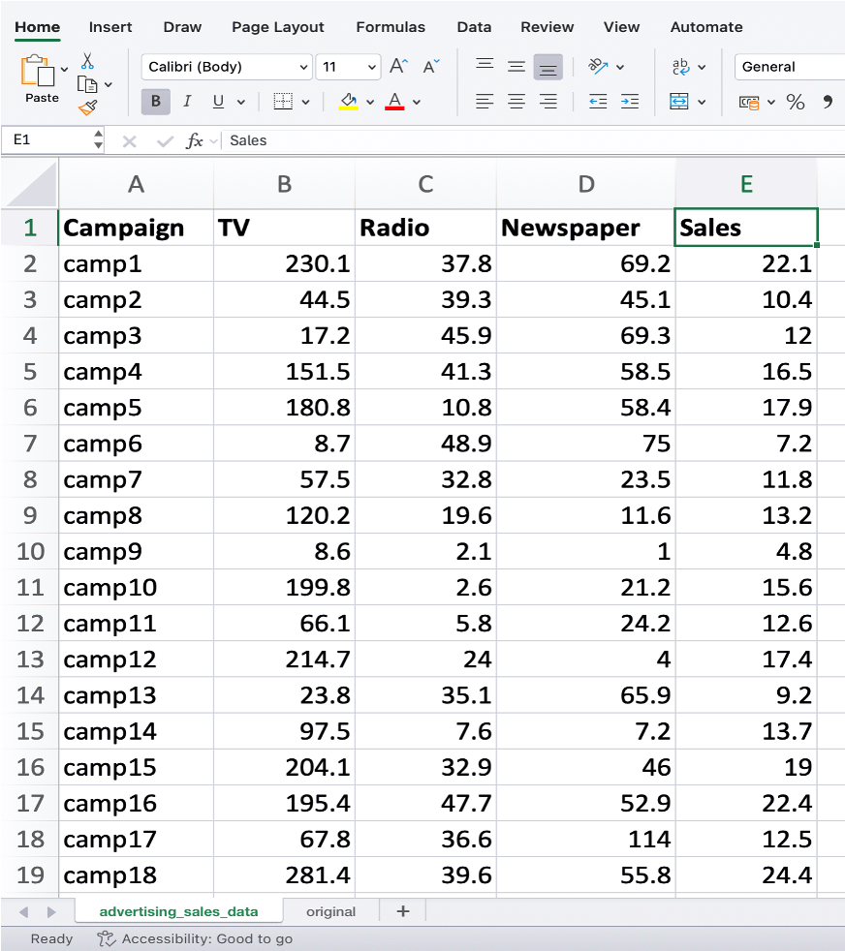
Dataset Overview
The dataset provided contains information about the advertising expenditures of a company on various platforms (TV, Radio, newspapers) and the corresponding sales of a product. There are 4 numerical variables -
TV : The amount of money spent on advertising the product on television.
Radio : Advertising expenditure on radio
Newspaper : Advertising cost spent on newspaper advertising.
Sales : The number of units sold corresponding to the advertising expenditures on TV, Radio, and newspapers.

Slide 4
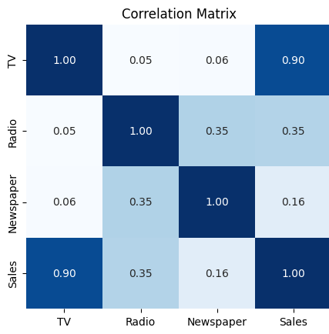
Impact of different media on sales
The average expenditure on each medium is -
TV : $146.79K
Radio : $23.26K
Newspaper : $30.69K
As per the correlation matrix and average expenditure, advertising expenditure on TV has the most impact on sales.

Slide 5
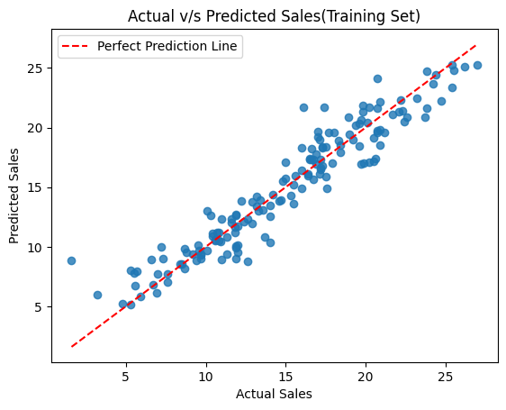
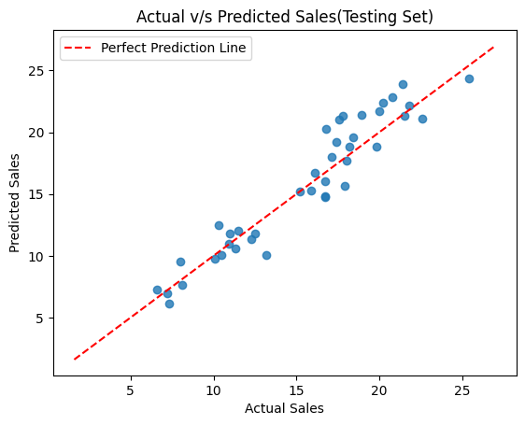
Linear regression model

Slide 6
Effect of normalization
Without Normalization
With Normalization
R² Score: 0.8830
MSE: 2.6808
Intercept: 4.5142
Coefficients:
0.05642276
0.10885805
-0.00445499
R² Score: 0.8830
MSE: 2.6808
Coefficients:
4.80894702
1.65120604
-0.09721829
Intercept: 15.0329
a
Thus, normalizing the dataset results in no change in model accuracy, since linear regression is scale-invariant. This is indicated by the same MSE and R² score.

Slide 7
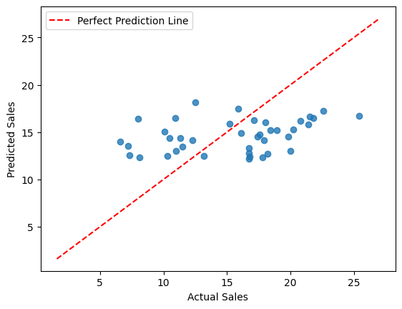
Regression model excluding tv expenditure
The predictions are poorly aligned with actual sales — indicating a weak linear relationship.
In the original dataset, TV advertising is often the most influential predictor of sales.
Omitting it removes a key explanatory variable, making the model incomplete.

Slide 8
conclusion
Advertising expenditures on TV and Radio show a strong positive impact on sales, with TV having the strongest impact.
Newspaper advertising shows a relatively weak relationship with sales, suggesting lower effectiveness in driving revenue.
The normalisation of data has no effect on the accuracy of the model. This is due to linear regression being a scale-invariant model
When only Radio and Newspaper are used as predictors, the model’s accuracy drops, confirming that TV is a crucial driver of product sales.

